Slide 1




REAL ESTATE DATA ANALYSIS USING EXCEL
STUDENT NAME: ADHITHYAN.S
REGISTER NO : 422200004
DEPARTMENT : III.B.COM(ISM)
COLLEGE : S.I.V.E.T COLLEGE

Slide 2

REAL ESTATE DATA ANALYSIS USING EXCEL

Slide 3


AGENDA
Problem Statement
Project Overview
End Users
Our Solution and Proposition
Dataset Description
Modelling Approach
Results and Discussion
Conclusion
3/21/2024 Annual Review

Slide 4

PROBLEM STATEMENT
In today’s real estate market, buyers, sellers, and renters face difficulties in efficiently finding properties that match their specific preferences. Despite the availability of numerous property listing platforms, the process of searching for suitable real estate options remains time-consuming and often yields irrelevant results. The lack of a tailored, smart property matching system creates frustration and inefficiencies for users, impacting their decision-making process.

Slide 5

PROJECT OVERVIEW
The objective of this project is to create a data driven play form that enhances the process of matching potential buyers and renters with real estate properties .The platform aims to streamline property searchers, improve agent client communication, and provide real time insights into market trends .This will help real estate agents and agencies optimize their processes while offering a more personalized and efficient property search experience to clients.

Slide 6

WHO ARE THE END USERS?
Home buyers
renters
real estate agents and brokers
real estate investors
property developers
landlords and property owners
tenants
property managers
real estate technology providers
banks and mortgage lenders
real estate analyst
insurance providers
Government and regulatory bodies
architects and designers

Slide 7

OUR SOLUTION AND ITS VALUE PROPOSITION
Our smart real estate property matching platform is a comprehensive, AI-driven tool designed to revolutionize the properties search and matching process. It leverages advanced machine learning algorithms, real time data analytics, and intuitive user interfaces to streamline property discovery, enhance user experience and empower real estate professionals with actionable insights.

Slide 8
Dataset Description
Property listings dataset
Market data dataset
User data dataset
Geographic and demographic data dataset
Transaction data dataset
Rental data dataset
Agent and broker data dataset
Economic and regulatory data dataset

Slide 9

THE "WOW" IN OUR SOLUTION
Hyper personalised property recommendations
Real time market insights and predictive analytics
Intuitive and interactive user experience
Advanced filtering and search capabilities
Seamless integration with proptech solutions
Enhanced Agent and broker tools
3/21/2024 Annual Review
9

Slide 10

MODELLING
10

Slide 11
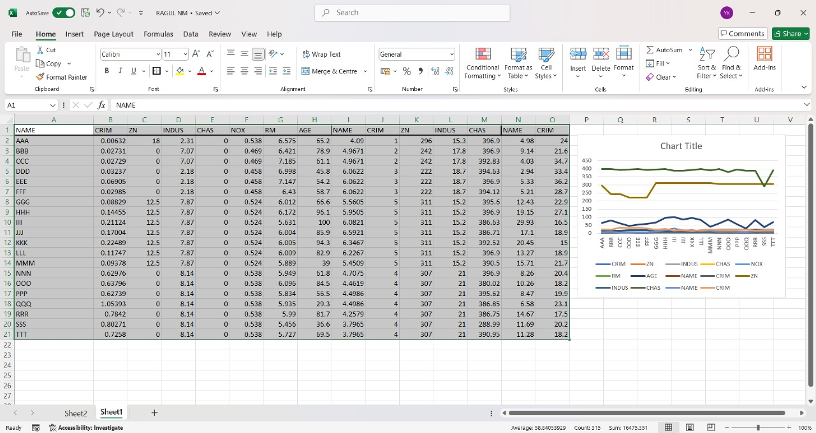
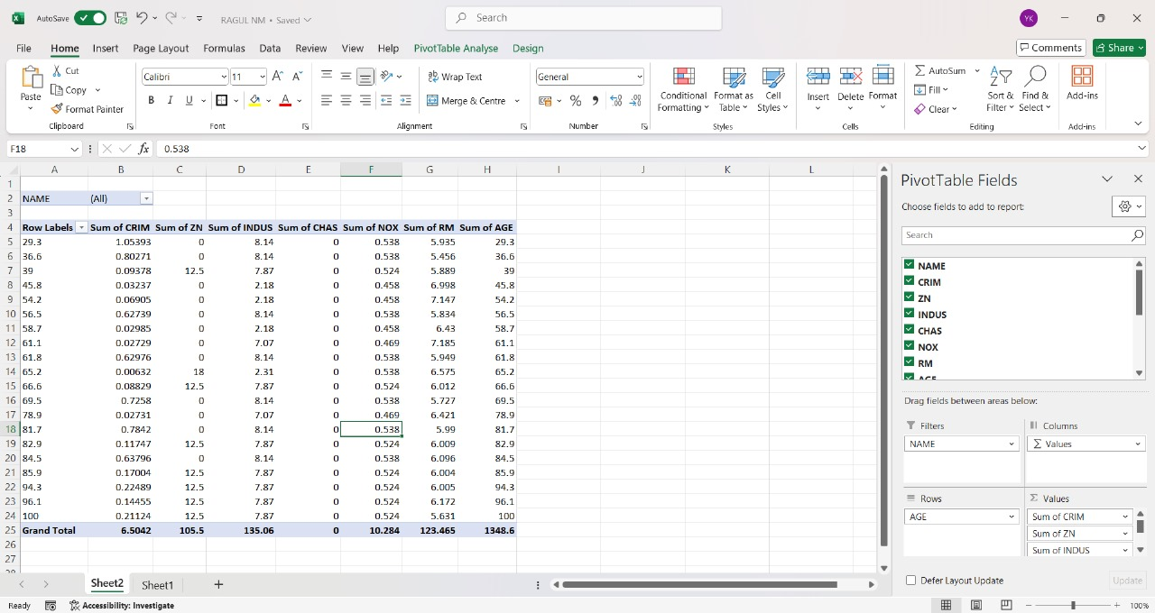
RESULTS
11

Slide 12
conclusion
Smart property matching platform improve the entire real estate ecosystem by making the search, buying, and under renting process more intuitive, data-driven, and customer centric. This platform stand to be an essential tool for modernizing real estate operations and enhancing overall efficiency

